Slide 1


Slide 2


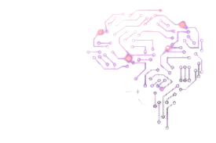
CODE VERSE HACKATHON 2025
Problem Statement Title - Build an AI tool that helps legal professionals rapidly search, sort, and summarize massive document dumps.
Team Name - Coder’s Guild
Team Members - 1) Yashwant Patil
2) Sarthak Galande
3) Sneha Tidke

Slide 3
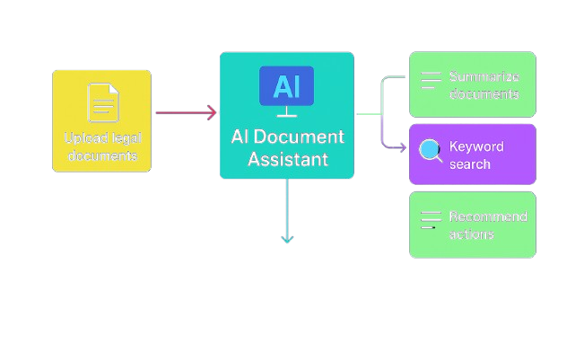
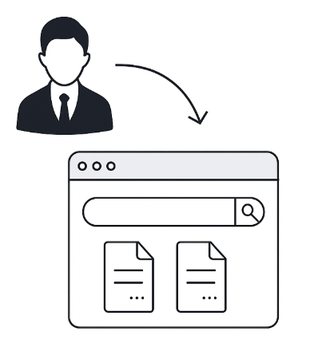
IDEA TITLE
Proposed Solution : AI Legal Document Assistant
-Rapid Case Preparation → Condenses hundreds of pages into short summaries.
-Legal Workflow Fit → Built specifically for contracts, case filings or case files.
-Easy to Use →
Just upload documents and get instant summaries.
🌐Innovation and Technique
The ability to summarize and utilize semantic search capabilities with LLM is a one-step tool
2. Easy to use interface is able to quickly organize and tag loaded documents.
3. Able to search massive dumps of document fast and reliable.

Slide 4
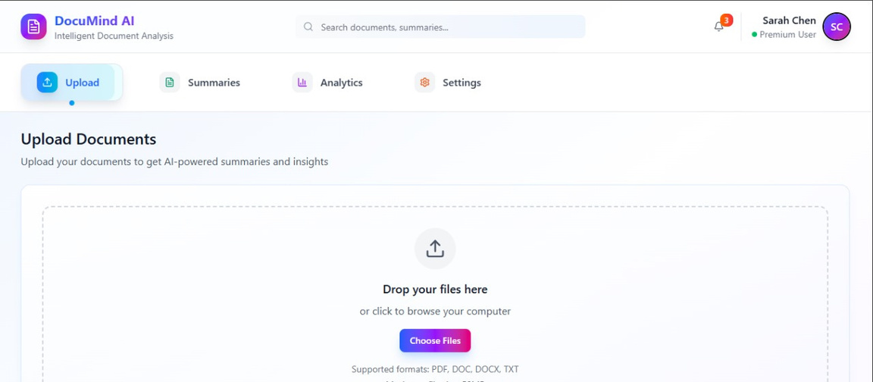
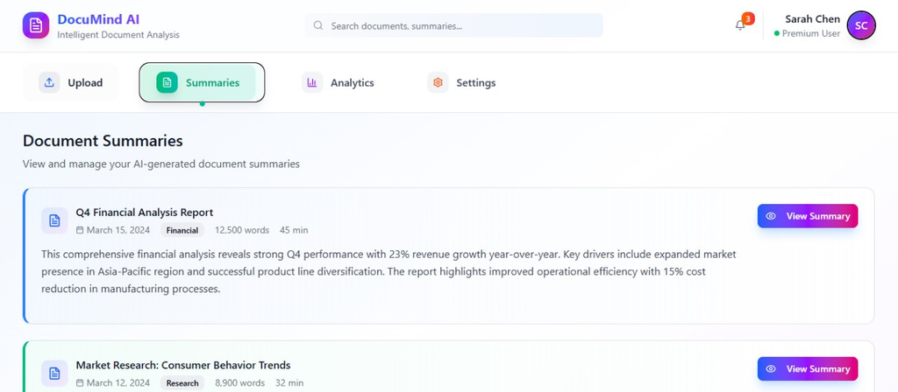
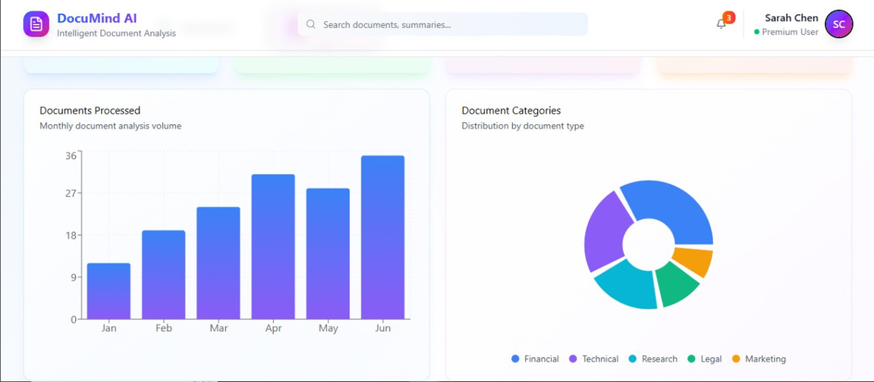
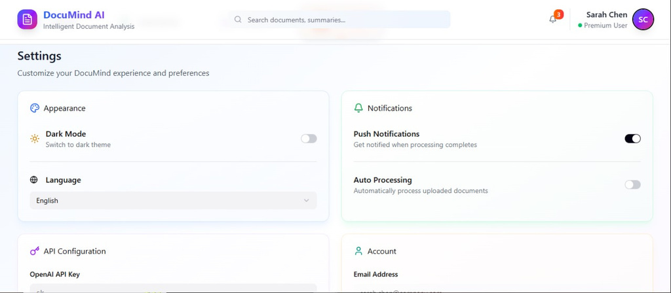
PROTOTYPE
Link For prototype dashboard

Slide 5
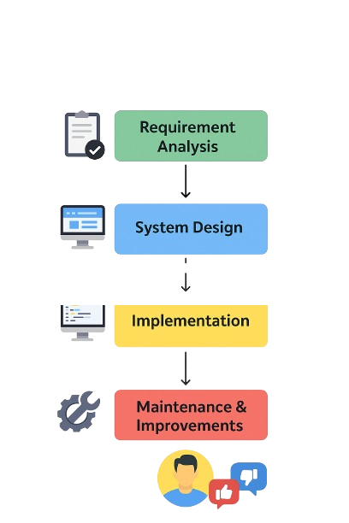






TECHNICAL APPROACH
Programming Languages:
Python:
For backend development
AI summarization
Search logic
HTML, CSS, JavaScript,React :
For frontend development Designing forms
User interaction.
Figma for design.
FastAPI Framework ,Uvicorn ,Dotenv files & environment variable, json.
Methodology And Process
For Implementation

Slide 6

FEASIBILITY AND VIABILITY
📊Feasibility
- Utilizes open-source frameworks (Python, Flask, Hugging Face), thus affordable.
- Will run on cloud (e.g., Heroku, PythonAnywhere).
- Constitutes a simple, user-friendly web interface for legal professionals.
💡Viability
-Feasible Build – FastAPI + React can be set up fast with APIs.
-Clear Use Case – Tackles summarizing & analyzing large docs.
-Scalable Demo – Start with single-file, expand to multi-docs.
-Hackathon Ready – MVP possible in 24–48 hours.
📝Strategies
- Text chunking together with NLP representation model that are less complex, eg., light.
- Services can be specialized legal AI models.
- Upgrade to semantic search improving factors of relevance.
🎲Risks
- Data privacy breaches if documents are not handled securely.
- Users may not trust AI completely.
- Performance will slow down, due to heavier document loads.
- Ensuring AI-summaries are accurate.

Slide 7



IMPACT AND BENEFITS
🚀Potential Impact
-Faster Case Preparation – Summarizes thousands of documents in minutes.
-Reduced Cognitive Load – Prevents lawyers from drowning in document dumps.
-Smarter Prioritization – Highlights the most relevant documents first.
👍Benefits
-Time Efficiency – Cuts down manual review hours drastically.
-Accuracy & Consistency – Summaries are structured and unbiased.
-Enhanced Productivity – Lawyers focus on strategy, not paperwork.
-Scalability – Handles massive volumes without extra manpower.

